Slide 1
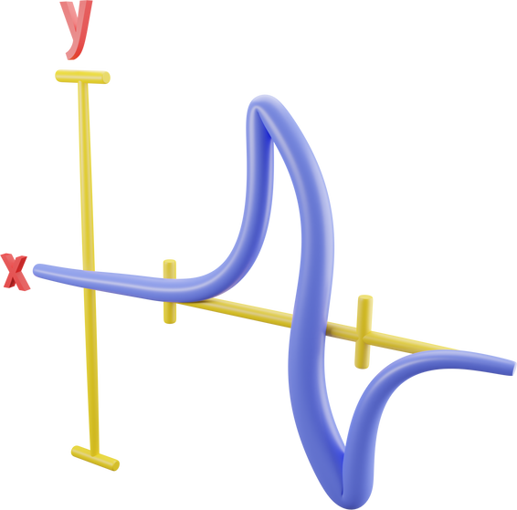











Get Started with
Data Visualisation with Python
by Michael Currie
Instructions before we start the class:
Rename yourself to this format: Nickname_Full Name
Make sure you are on your Laptop with Python 3.7+ and a text editor installed (e.g. Sublime, VSCode)
If you have any questions, feel free to unmute yourself or post in the chatbox

Slide 2


Learn. Grow. Work in Tech.

Slide 3


Learn. Grow. Work in Tech.
Our platform leverages AI-assisted technology to provide startups with an efficient and cost-effective means of finding and retaining top regional talents. We aim to streamline the recruitment process for both companies and job seekers, enhancing the overall job search experience.
AI-POWERED MATCHING
EMPLOYER BRANDING
TALENT NURTURING
A smart job + machine learning assessment tools + existing psychometric assessment tools is a feature that uses AI to analyze and assess the suitability of candidates for a particular job or company.
Our technology platform curates optimized content for company goals through localized promotion and nationwide brand expansion. Features include company bios, industry highlights, interviews, and visually appealing content.
Our Talent Nurturing Feature offers personalised talent development through tracking, skill gap identification, and custom learning recommendations. It helps organisations attract, retain, and grow employees for increased productivity and success.

Slide 4
Learn. Grow. Work in Tech.
OUR TALENT POOL
Currently, we have 3000+ active professionals in our talent pool, 70+ B2B Clients, 10+ Strategic partners, and 7,800+ Followers on our media channels.
Co-founder, C-Level
8.41%
Design
10.44%
Engineering
10.40%
Finance
1.94%
Marketing
19.30%
Operations
13.38%
Product
15.42%
Recruiting, HR
8.36%
Sales, BD
13.20%
Science
2.40%
Support, CS
9.00%
0%
5%
10%
15%
20%

Slide 5





Learn. Grow. Work in Tech.
OUR SOCIALS
CONTACT US
@resonance_wn
admin@whatnot.co
@Resonance
@Resonance
@Resonance

Slide 6


Slide 7
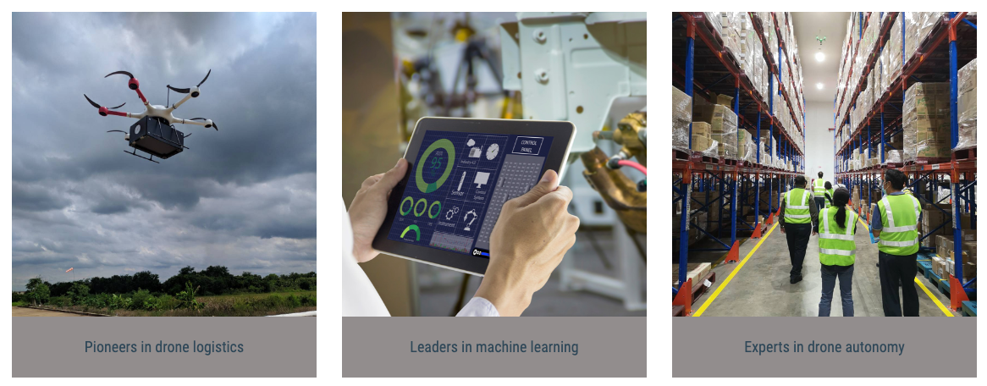

Slide 8


Fling.asia
Fling
Fling: Intelligent Solutions for Digital Transformation
Fling.asia

Slide 9



WHY TAKE THIS CLASS?
Learn about Cutting Edge Programming Techniques
Certificate of Participation for those that complete the class
Internship and Job Opportunities

Slide 10

QUESTIONS FOR YOU
Do you program in Thai or English?
What's your biggest challenge to become better at programming?
What's your favourite type of chart?

Slide 11


CLASS AGENDA
Slide 2: What is Python? – A Brief Overview
Slide 3: The Python Data Analysis Toolkit: Introduction to Pandas
Slide 4: Data Manipulation with Pandas – Overview
Slide 5: Demonstration: A Simple Data Analysis with Pandas
Slide 6: Visualizing Data: The Role of Matplotlib in Python
Slide 7: Key Features of Matplotlib – An Overview
Slide 8: Demonstration: A Basic Matplotlib Plot
Slide 9: Types of Plots: From Scatterplots to Histograms
Slide 10: Customizing Your Plots: Styles, Labels, and Legends
Slide 11: Interactive Visualization: Using Widgets with Matplotlib
Slide 12: Case Study: From Data to Insights Using Pandas and Matplotlib
Slide 13: Best Practices for Effective Data Visualization
Slide 14: Resources for Further Learning: Books, Courses, and Websites
Slide 15: Q&A and What to Expect in the Next Two Hours

Slide 12
SETUP
Install Anaconda
conda create --name env1 python=3.10?conda activate env1
Terminology Note: You may be a little bit confused about conda versus Anaconda. The distinction is subtle but important. Anaconda is a distribution of Python that includes many of the necessary packages for scientific work of all kinds. conda is a cross-platform package management software that is included with the Anaconda distribution of Python. conda is the software that you use to build, install, and remove packages within the Anaconda distribution.

Slide 13


NumPy (Numerical Python) is a popular open-source Python library that provides support for large, multi-dimensional arrays and matrices, as well as a wide range of mathematical functions to operate on these arrays efficiently. It is one of the fundamental libraries used in scientific computing and data analysis in Python.
NumPy is designed to be efficient and performant, especially when dealing with large datasets and numerical computations. It achieves this by implementing array operations in a highly optimized manner, often leveraging low-level implementations written in C or Fortran.
NumPy was initially developed by Travis Olliphant, a software developer and data scientist, in 2005.
Travis Oliphant
pip install numpy

Slide 14


pandas is a Python package that provides fast, flexible, and expressive data structures designed to make working with "relational" or "labeled" data both easy and intuitive. It aims to be the fundamental high-level building block for doing practical, real world data analysis in Python. Additionally, it has the broader goal of becoming the most powerful and flexible open source data analysis / manipulation tool available in any language. It is already well on its way towards this goal.
Wes McKinney
pip install pandas

Slide 15

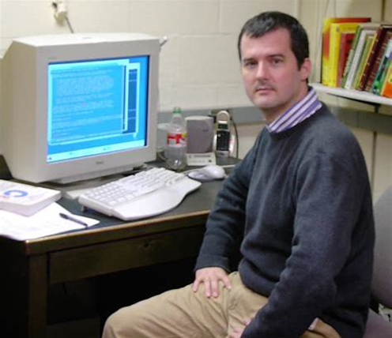
“Mathematics Plotting Library”
Created as an open-source clone of MATLAB
Matplotlib is a plotting library for the Python programming language and its numerical mathematics extension NumPy. It provides an object-oriented API for embedding plots into applications using general-purpose GUI toolkits like Tkinter, wxPython, Qt, or GTK. There is also a procedural "pylab" interface based on a state machine (like OpenGL), designed to closely resemble that of MATLAB, though its use is discouraged. SciPy makes use of Matplotlib.
Matplotlib was originally written by John D. Hunter. Since then, it has had an active development community and is distributed under a BSD-style license. Michael Droettboom was nominated as matplotlib's lead developer shortly before John Hunter's death in August 2012 and was further joined by Thomas Caswell. Matplotlib is a NumFOCUS fiscally sponsored project.
John D. Hunter

Slide 16
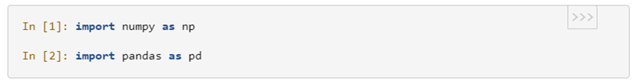
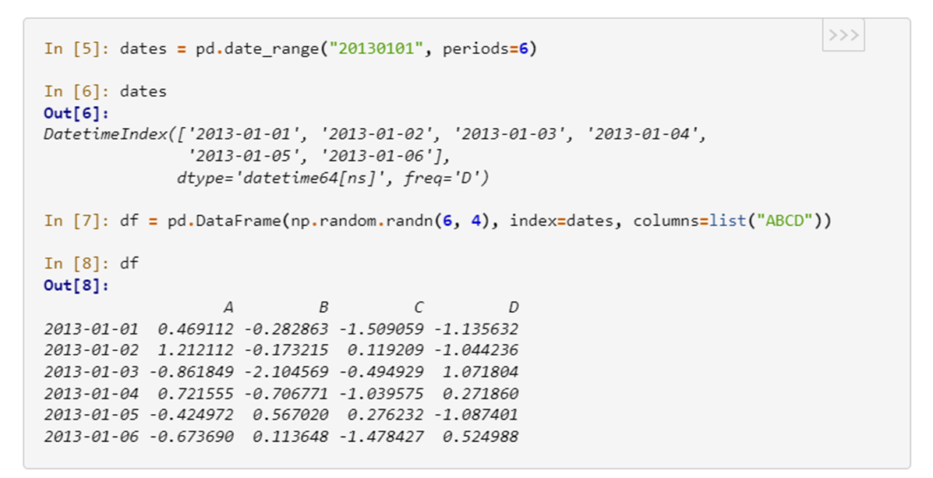
PANDAS “HELLO WORLD”

Slide 17
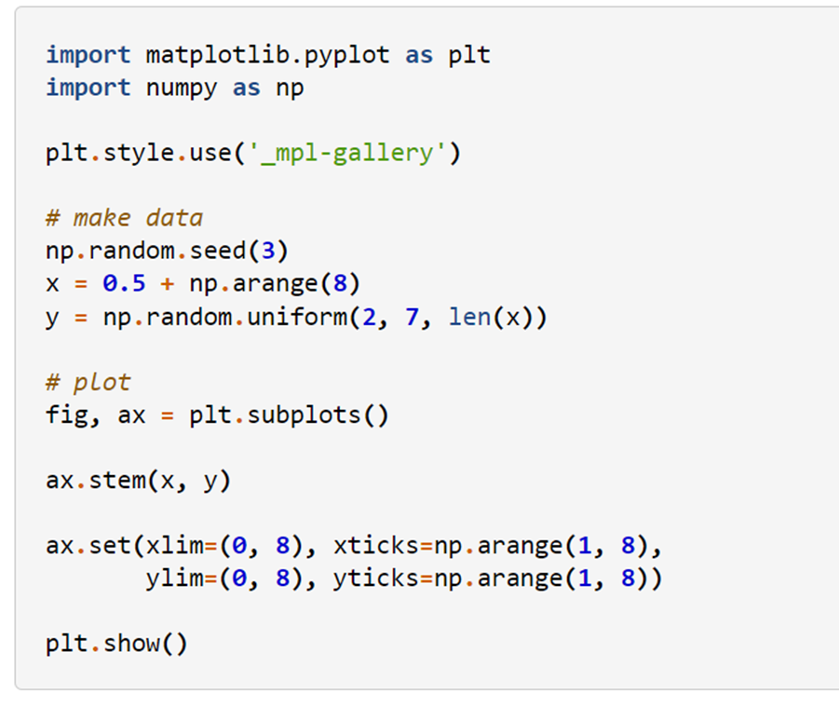
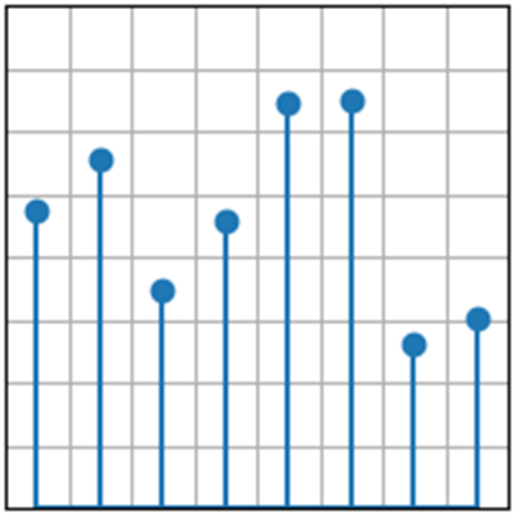
MATPLOTLIB “HELLO WORLD”

Slide 18

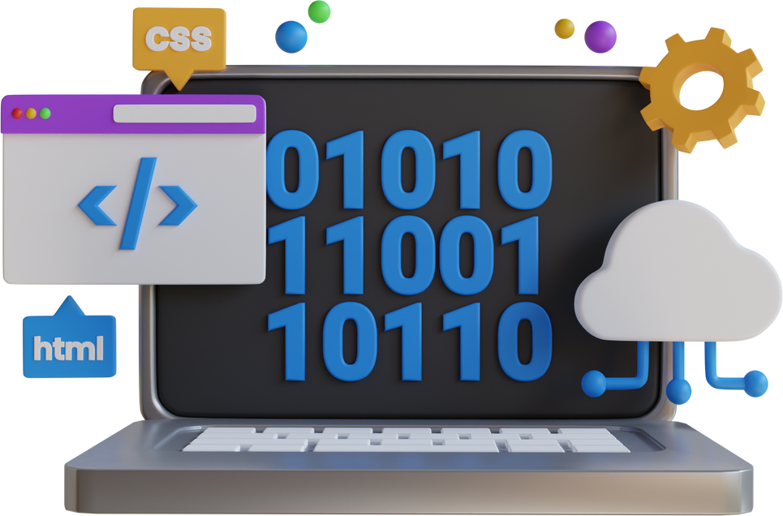
TOP PROGRAMMER TIPS
1
FIND TIME TO FOCUS
(ZOMBIE TIME)
2
MAKE A SIMPLE EXAMPLE TO PROVE A NEW FUNCTION
3
MAKE SMALL CHANGES, THEN COMMIT THEM

Slide 19
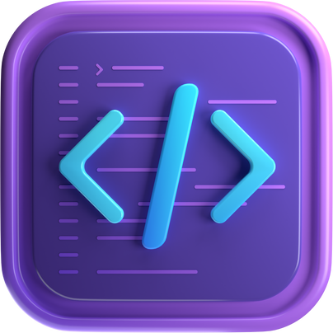
LIVE CODING WITH MICHAEL

Slide 20
PROBLEM 1: TITANIC SURVIVORS
import pandas as pd
import matplotlib.pyplot as plt
# You can replace the file path with your local path where the CSV file is located.
df = pd.read_csv('https://raw.githubusercontent.com/datasciencedojo/datasets/master/titanic.csv')
# Let's check the first few rows of the dataframe to see what the data looks like.
print(df.head())
# Group the data by 'Sex' and 'Survived', and then count the number of passengers.
survived_by_sex = df.groupby(['Sex', 'Survived']).size().unstack()
# Plot the bar chart.
survived_by_sex.plot(kind='bar', stacked=True)
plt.title('Survival by Sex')
plt.xlabel('Sex')
plt.ylabel('Count')
plt.show()

Slide 21
PROBLEM 2: AIRLINE PASSENGERS
import seaborn as sns
import matplotlib.pyplot as plt
# Load the flights dataset
flights = sns.load_dataset("flights")
# Let's check the first few rows of the dataframe to see what the data looks like.
print(flights.head())
In the heatmap, the x-axis represents years, the y-axis represents months, and the color intensity represents the number of passengers. The "annot=True" argument means that the actual numbers will be shown in the cells of the heatmap, and "fmt='d'" means that these numbers will be formatted as integers. The "cmap='YlGnBu'" argument sets the color map to be used for the heatmap.
# Pivot the dataframe
flights_pivot = flights.pivot("month", "year", "passengers")
print(flights_pivot) # Create a heatmap
plt.figure(figsize=(10,8))
sns.heatmap(flights_pivot, annot=True, fmt="d", cmap="YlGnBu")
# Show the plot
plt.show()

Slide 22
CHALLENGE PROBLEMS

Slide 23
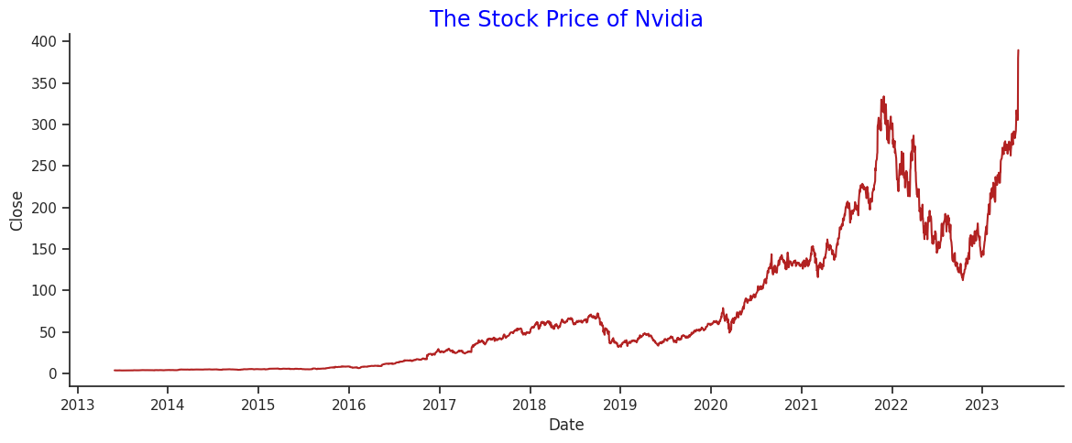
CHALLENGE PROBLEM 1:
Plot a stock price of any publicly listed company with data from YahooFinance

Slide 24

GOOD LUCK

Slide 25
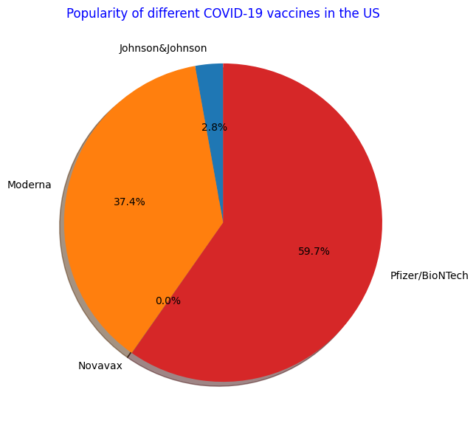

CHALLENGE PROBLEM 2:
Visualize the popularity of different COVID-19 vaccines with a pie chart
Source: https://raw.githubusercontent.com/owid/covid-19-data/master/public/data/vaccinations/vaccinations-by-manufacturer.csv

Slide 26
GOOD LUCK

Slide 27
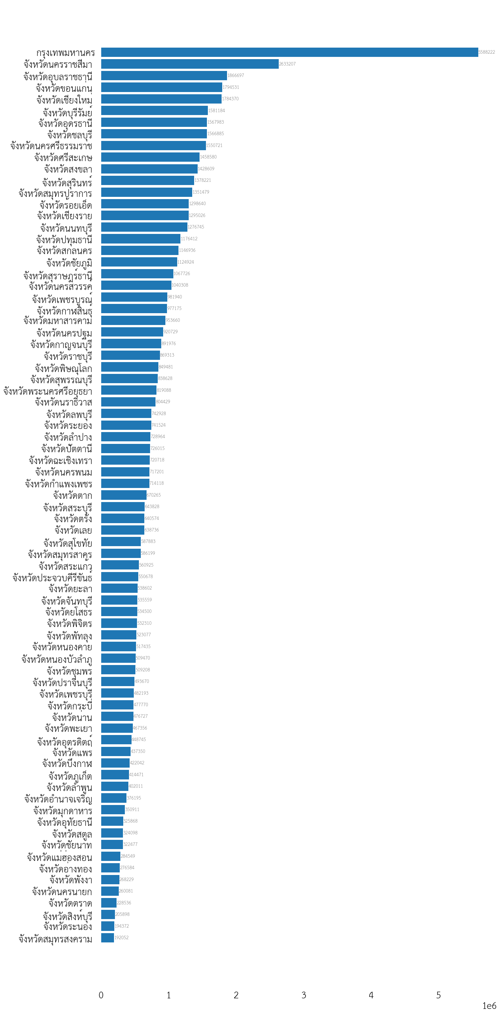

CHALLENGE PROBLEM 3:
Visualize the population of different provinces in Thailand
Source: https://data.go.th/dataset/c6fb53a5-4d9d-4f21-84a7-9662b25af9c3/resource/225ff892-3874-4072-9787-a2c30128e3f7/download/stat_c.txt

Slide 28
GOOD LUCK

Slide 29



Solution in Google Colab
CHALLENGE #1
CHALLENGE #2
CHALLENGE #3
Notes:
Challenge#1: https://colab.research.google.com/drive/1weRaZpHQCbB9fWptSqQ0rsjuHHEAwlmN?usp=sharing
Challenge#2: https://colab.research.google.com/drive/1wM1necYz2pFK9e1ij3S1GnYw8FlNxt1e?usp=sharing
Challenge#3: https://colab.research.google.com/drive/1LwS6dVcSKhyp8NiI8AW4IOX15RopBvjc?usp=sharing

Slide 30

RESULTS & QnA

Slide 31


THANK YOU
Let us know your opinions on the class so we can improve and do more in the future!

